Slide 1
Big Mountain Resort
Ticket Price Modeling
Prepared by Vincent Tolentino

Slide 2
Identifying our Problem
What is the current ticket price for Big Mountain Resort? How do you come up with that price point?
$81
A premium added to the average price of resorts in its market segment determines current ticket price
Not sustainable
Limitations (like relying on ticket prices of other resorts)
Potentially losing out on revenue
Not capitalizing the numerous facilities BMR has to offer
Hampers investment strategy

Slide 3
The Solution to our Problem
We must value the ticket price not only based on the average ticket price of the market, but on the unique features of Big Mountain Resort, with respect to other resorts within its market segment
Analysing and modeling our given data will yield a more precise ticket price prediction
Utilize various features found in BMR and other resorts to account for ticket price discovery
Reduce the lost revenue from arbitrary ticket price placement
Open up access to explore and process scenarios that alter various features of BMR
Support an investment strategy for future feature investment

Slide 4
Recommendation Key findings
Our recommendation from our modeling suggests an increase in ticket prices is justified. With an expected number of visitors at 350,000, and an average 5 day ski trip for each of those visitors, an increase in ticket price could generate additional millions in revenue. Our current model based on ticket price alone indicates an increase to $95.87. Within our market context, our model indicates additional features like a vertical drop and chair lift would warrant an increase in ticket prices by $1.99, which is enough to cover the costs of the addition.
Big Mountain Resort ranks among the highest in many features among the 300+ other resorts
Correlations between features were discovered that shed insight into the resorts
More night skiing found in more densely populated areas
Visitors value guaranteed snow over total terrain area
Linear Regression Model suggests vertical drop as the biggest positive feature
Random Forest Model suggest fastQuads and runs as the biggest positive features

Slide 5
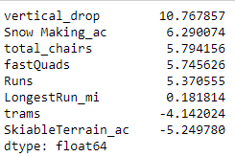
Linear Regression Model Results
Linear Regression Model Results
Linear regression model showing the most positive features of our dataset
Vertical drops, by far, have the most positive effect on ticket prices for our resort
Is this the best model?

Slide 6
Analysis
Our Linear Regression Model was able to produce a cross-validation mean absolute error of 10.50 and a standard deviation of 1.62
These values seem okay, however, there is another model that we can test using our data that may prove to be a much better fit.

Slide 7
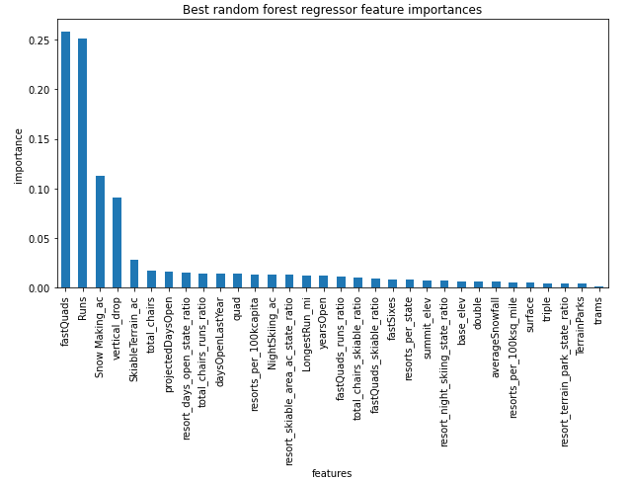
Random Forest Model Results
Random forest model showing the most positive features of our resort
This indicates the top two positive features are fastQuads and Runs for our resort
Let’s try this model

Slide 8
Analysis
Our Random Forest Model was able to produce a cross-validation mean absolute error of 9.64 (as opposed to 10.50 from the LR Model) and a standard deviation of 1.35 (as opposed to the 1.62)
The random forest model has a lower cross validation MAE and less variability, making it the best model of the two for predictions on price, which was why it was used to determine the solution to our pricing problem.

Slide 9
Summary and Conclusion
Amongst the over 300 resorts in our dataset, Big Mountain Resort boasts a high position in most features
With this in mind, it is logical to include these features in our determination for ticket prices for future sales
Raising the ticket price is not only rational, but can be backed with modeling data that has been provided
Our modeling through the Random Forest Model can predict changes in these features, with respect to ticket prices, with minimized variance
Implementing additional data (i.e. ticket sales information and operating costs) can further pinpoint better price strategy for the future market of Big Mountain Resort

Slide 10
Final Thoughts / Questions?

